Slide 1
The Battle of Hikki'ya' (Ackia)
Secondary Student Curriculum
The Chickasaw Nation
Unit 3: Lesson 1

Slide 2
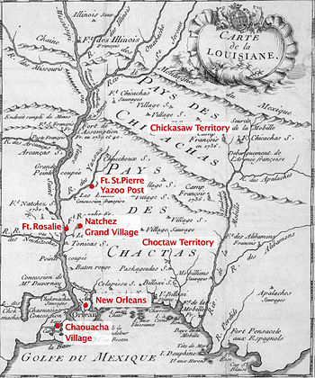
Prelude to Battle
On November 28, 1729, the aggravated Natchez warriors launched a revolt against the French for their transgressions at Fort Rosalie and the Natchez post settlement established by the French (Atkinson, 2004, p. 35).
French map of locations

Slide 3
Prelude to Battle cont.
This destruction of the settlement began a war between the French and the Natchez in which the French drove the Natchez from their homeland.
The Chickasaws offered refuge to two towns of the Natchez within their settlements in early 1731 (Atkinson, 2004, pp. 35-36). The Natchez acceptance of the Chickasaws angered the French, so they began to gather all the American Indian allies they could in order to defeat the Chickasaw Nation (Atkinson, 2004, p. 36).
In addition to their adoption of the Natchez, the Chickasaws’ previously existing alliance with the British only cemented the French resolve to destroy the Chickasaws, as well as the Natchez.

Slide 4
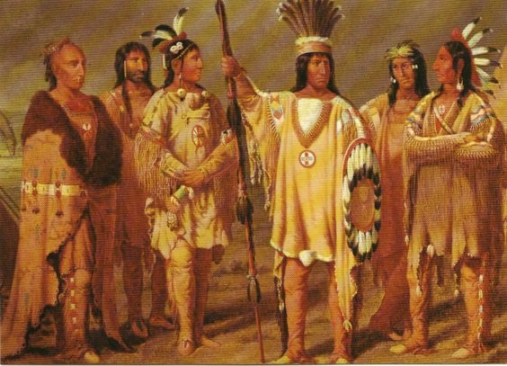
Huron Indians
Two months after the Fort Rosalie attack, Louisiana governor Perier de Salvert began trying to persuade northern Indians (the Illinois and the Huron mostly) to attack the Chickasaws so the French didn’t have to declare war on them (Atkinson, 2004, p. 36). Perier had decided he wanted to destroy the Chickasaw Nation (Atkinson, 2004, p. 36). The Huron and Illinois began organizing attacks against the Chickasaw.

Slide 5
Prelude to Battle cont.
The French demanded that the Chickasaws surrender the Natchez people to them, but the Chickasaws refused.
Many attacks on the Chickasaws were made by the Choctaws and northern Indians.

Slide 6
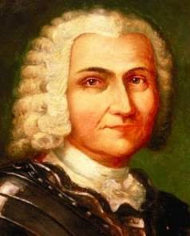
Prelude to Battle cont.
Sieur de Bienville
The Chickasaws asked for peace several times to no avail, until Jean-Baptiste Le Moyne, Sieur de Bienville (Louisiana governor following Perier) made a deal with Chickasaw leaders (Atkinson, 2004, p. 41).
He would allow them three months of peace to plan an attack on the Natchez, and after the Chickasaws destroyed the Natchez, he would leave them be.
Not wanting to attack the Natchez, the Chickasaws presented excuses for why they could not oblige, the main reason being that the Natchez were still too numerous and strong, even though some had recently moved east (Atkinson, 2004, p. 41).
In April 1735, however, French soldiers came across Chickasaw and Natchez warriors who were on their way to retrieve some of their captured women from the northern Indians. The French opened fire, and the Chickasaws/Natchez fired back (Atkinson, 2004. p. 41).

Slide 7
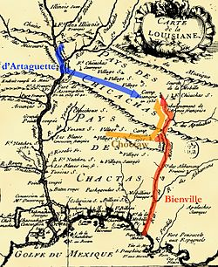
Prelude to Battle cont.
Bienville then began preparing to take his French and Choctaw forces and attack the Chickasaws himself. He explained that he had orders to attack the Natchez first, but the “Great Chief” of the Choctaws came and asked to attack Chukafala [pronounced chuk-kah-fah-lah] (Long Town) first because it gave them the most trouble (Atkinson, 2004, p. 54).
Route of French army to Chickasaw villages

Slide 8
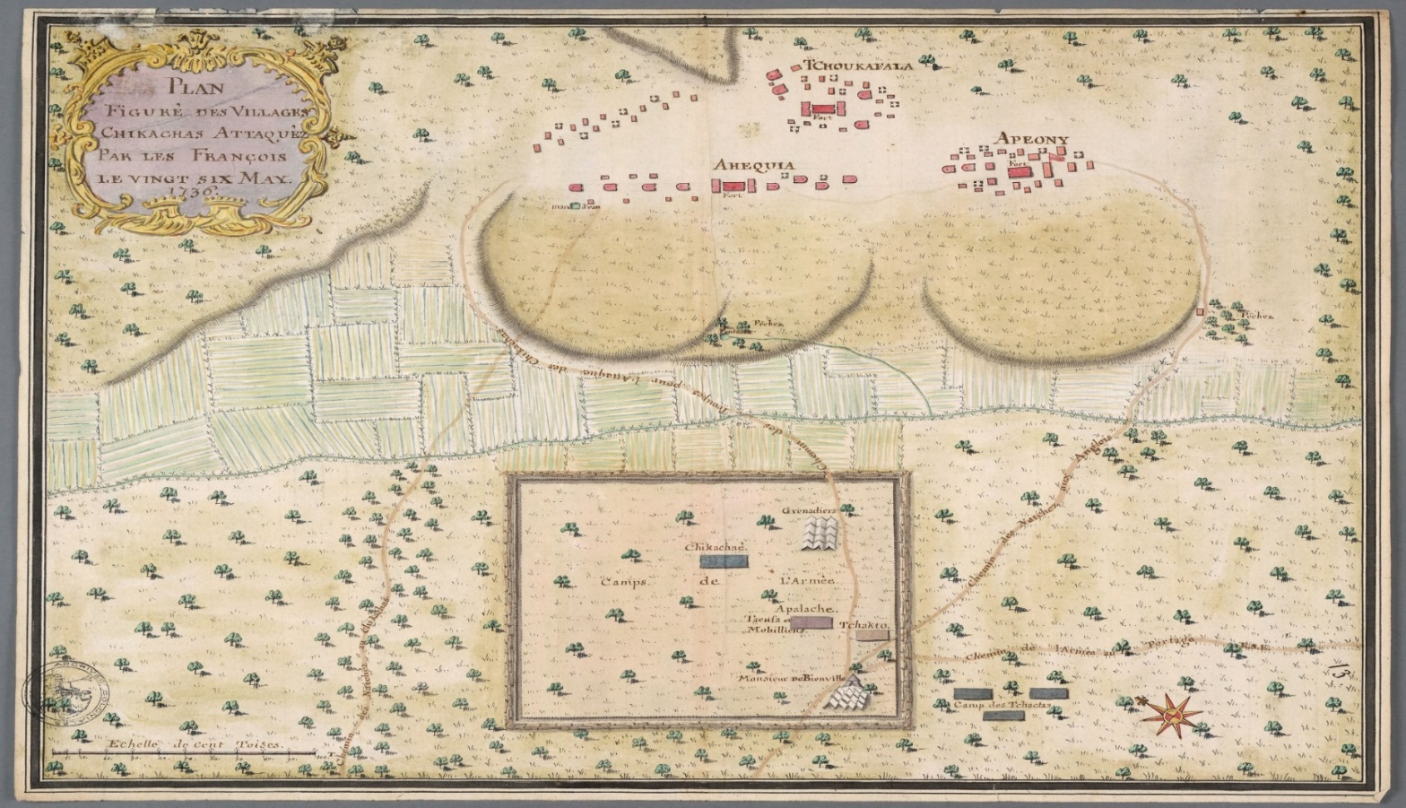
Prelude to Battle cont.
Bienville said they would attack the Natchez first, then the Chickasaw village of Chukafala. The Choctaws nevertheless led him to the small prairie where Hikki'ya' [hick-key-uh], Apeony [ap-poo-knee] and Chukafala were, instead of to the Natchez (Atkinson, 2004, p. 54).

Slide 9
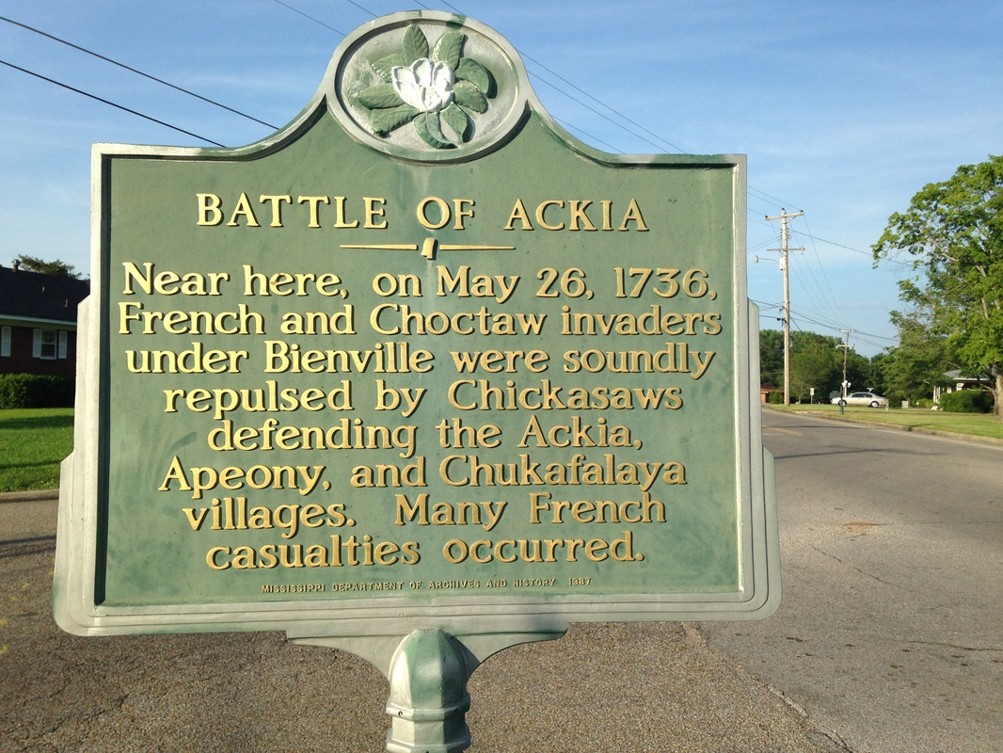
Prelude to Battle cont.
After a small conflict with the Chickasaws outside of the prairie, Bienville was coerced to attack Chukafala before the Natchez. When observing the three villages on the small prairie, Bienville believed there to be English influence at Apeony, so he decided to attack Hikki'ya' first in order to avoid firing on British subjects, with whom France was not in a declared war with at the time (Atkinson, 2004, p. 54).
In theory, after capturing Hikki'ya', the French and Choctaw would be able to assault the Natchez towns located just a few miles away.

Slide 10
Prelude to Battle cont.
The Chickasaw village Hikki'ya', formerly known as Aahikki‘a‘ meaning “Lookout station” (Dyson, 2014, p. 71), was led by the Chickasaw leader Ymahatabe, who had been devoting himself to promoting peace for the last six years (Atkinson, 2004, p. 54).
The name Ymahatabe [yah-ma-ha-tuh-bee] is the anglicized spelling of Immayyat Abi' meaning “He overcame him and killed him” (Dyson, 2014, p. 71).
Given the irony of the French attack on the peaceful village of Hikki'ya', it only seems fitting that the village would bear the brunt of the French attack, the results of which would serve to teach the French that direct warfare against the Chickasaws was not something to take lightly (Atkinson, 2004, p. 54).

Slide 11
The Battle Itself
Bienville prepared for an attack on May 26, 1736. Bienville’s entire force included:
50 grenadiers
270 French soldiers
159 French militia and volunteers
100 Swiss mercenaries
45 French-African soldiers
This force was led by 35 French officers, six Swiss officers and 600-700 Choctaw allies.

Slide 12
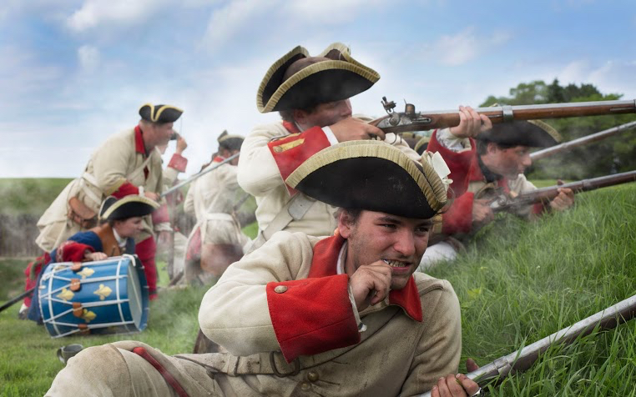
The Battle cont.
Thus, the total French force was about 1,300 men, almost twice the number of warriors in the entire Chickasaw Nation. A company of French-African soldiers attacked first, bearing mantlets, or thick padded mats. They were hit by gunfire and arrows from the Chickasaws. As confusion and chaos ensued, the African soldiers began fleeing the area, leaving grenadiers exposed to fire. Grenadiers fled and set cabins afire to distract the Chickasaws (Atkinson, 2004, p. 55).
French reenactment soldiers

Slide 13
The Battle cont.
Captain Joseph DeLusser was shot and killed in front of his men, so the French soldiers cowered behind the burning cabins (Atkinson, 2004, p. 55). DeLusser’s death left Chevalier Denoyan and approximately 30 men exposed heading up the hill to the battle of Hikki'ya'. Within minutes, Denoyan was hit. Denoyan saw his men going down one by one and called for reinforcements.

Slide 14
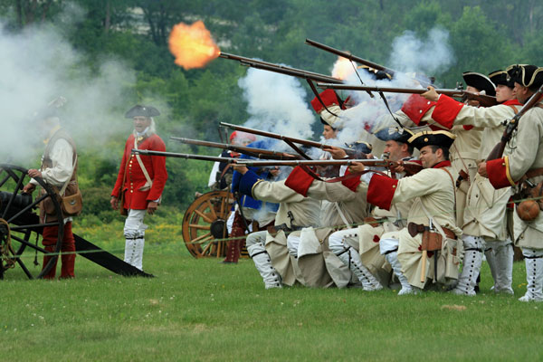
The Battle cont.
French reenactment soldiers
The soldiers became easy targets for the Chickasaws because they were shooting from holes in the fort’s walls. The Chickasaw palisade forts were seven-foot-high walls that leaned inward (Atkinson, 2004, p. 59). The French could not directly see them, much less hit them with gunfire.
About 70 men lay dead or wounded around the Chickasaw’s fort, including Denoyan. Bienville watched from a distance as his army and victory fell to pieces.

Slide 15
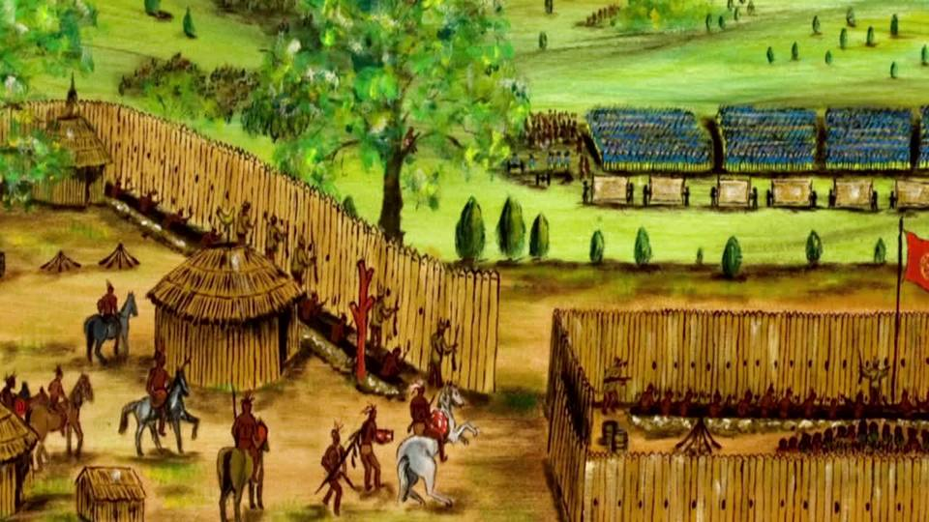
The Battle cont.
Artist rendering of battle
Chickasaws continued to fire from the holes in the fort with increasing rapidity. Bienville sent Captain Jadart de Beauchamp and 150 soldiers to carry out a retreat (Atkinson, 2004, p. 56).

Slide 16
The Battle cont.
Many French soldiers desperately tried to drag their dead and wounded to safety, becoming targets of their own in the chaos (Atkinson, 2004, p. 56). The French fled the Chickasaw village of Hikki'ya'.
An important element of the battle was the French attempt to ascend the prairie ridge the three Chickasaw forts occupied via a ravine or gulley.

Slide 17
The Battle cont.
The French or Choctaws shot Chickasaw peace emissaries who came out bearing pipes of friendship and peace before the battle (Atkinson, 2004, p. 54). These were some of the only confirmed Chickasaw casualties for which the French could account.

Slide 18
Consequences
While no one knows for sure the number of Chickasaw casualties, they appear to be quite minimal. On the other hand, Bienville reported 24 killed and 52 wounded. Those numbers appear to be vastly under-reported and probably should be significantly higher. Included in those numbers were many of Bienville's critical officer’s corps. Their loss is almost immeasurable, but it greatly weakened Bienville's military and their ability to carry out further attacks as he and the French had originally planned.

Slide 19
Consequences cont.
The French defeat was exceptionally humiliating and embarrassing, and the reputation of the French military nosedived among the tribes in the region. In particular, to some Choctaw leaders, it showed that the French were poor and unreliable allies.
It certainly demonstrated to the British how important of an ally the Chickasaw Nation was -- one from whom they needed to continually court favor.

Slide 20
Consequences cont.
This marked the beginning of the end for the French empire’s plan to link its northern boundaries in New France to its southeastern colony of Louisiana, which included the critical port city of New Orleans and control of the Mississippi River.
France abandoned most of its efforts to colonize and expand in North America following the French/Indian (Seven Years) War in 1763 and their inability to consolidate its territories.

Slide 21
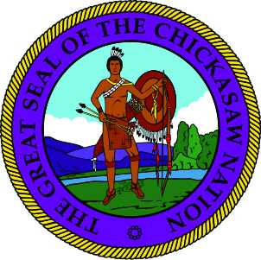
Consequences cont.
The Chickasaw Nation was victorious against long odds and vastly outnumbered.
Defeating the powerful French imperial military and their Choctaw allies further enhanced the Chickasaw reputation as fierce warriors, where the whole community played a role in continuing to be “Unconquered and Unconquerable.”
This iconic reference to the Chickasaws reinforced that they were not to be taken lightly.
The Great Seal of
the Chickasaw Nation

Slide 22
Reference List
Atkinson, J. R. (2004). Splendid Land, Splendid People: The Chickasaw Indians to Removal. Tuscaloosa, Alabama: University of Alabama.
Dyson, J. (2014). The Early Chickasaw Homeland. Ada, Oklahoma: Chickasaw Press.

